Slide 1

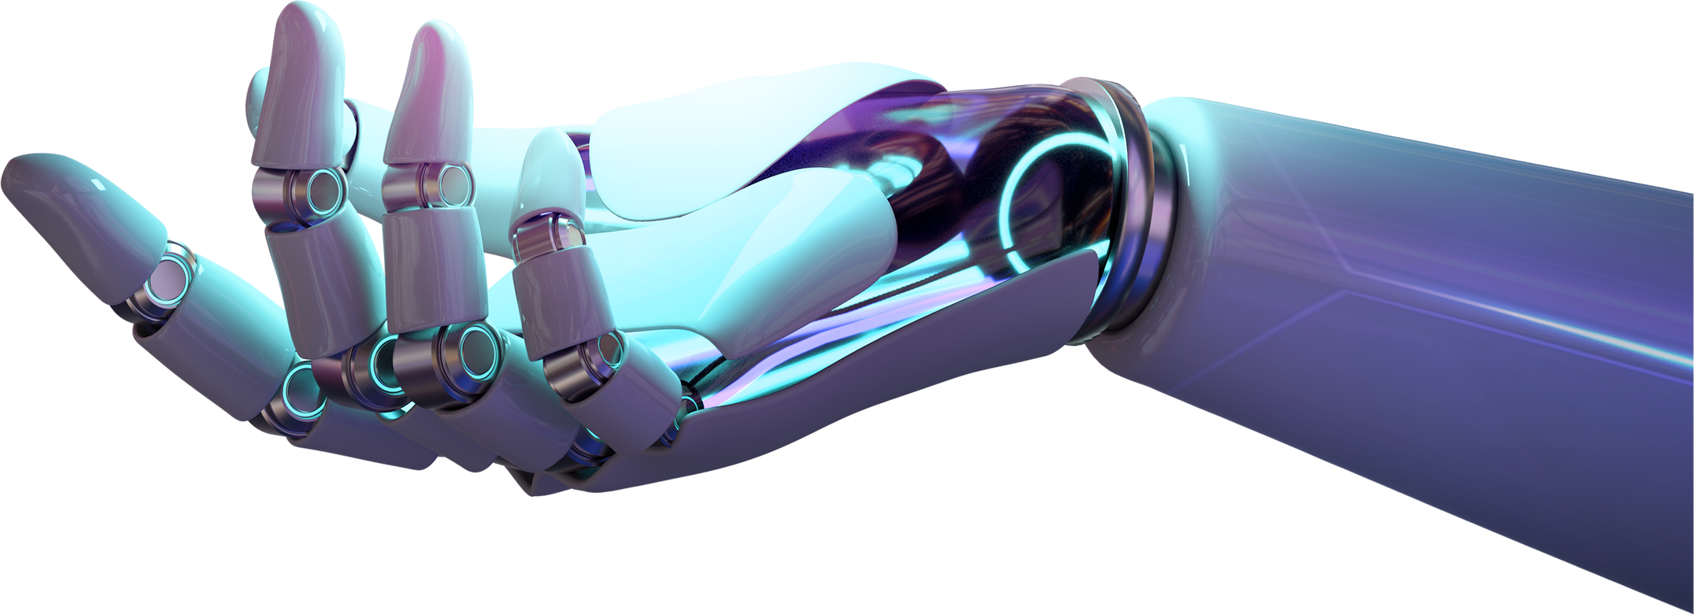
GOOGLE LaMDA
Réaliser par :
Chaimaa Bouabd
Aimad Benzakry

Slide 2




GooGle LaMDA

Slide 3
Introduction to LaMDA
Notes:
Artificial intelligence (AI) has come a long way in recent years, and Google has been at the forefront of this technological revolution. One of the latest breakthroughs in the field is the development of the LaMDA (Language Model for Dialogue Applications) system. LaMDA is an AI language model that is designed to enable computers to converse with humans in a more natural and engaging way than ever before. In this presentation, we will explore what LaMDA is, how it works, and what it means for the future of AI.

Slide 4
What is Lamda ?
LaMDA, short for Language Model for Dialogue Applications, is a family of conversational LLMs developed by Google.
LaMDA, a family of Transformer-based neural language models designed for
dialog. These models’ sizes range from 2B to 137B parameters, and they are pre-trained on a dataset of 1.56T words from public dialog data and other public web documents . LaMDA makes use of a single model to perform multiple tasks: it generates potential responses, which are then filtered for safety, grounded on an external knowledge
source, and re-ranked to find the highest-quality response.
google scientific article
Notes:
Artificial intelligence (AI) has come a long way in recent years, and Google has been at the forefront of this technological revolution. One of the latest breakthroughs in the field is the development of the LaMDA (Language Model for Dialogue Applications) system. LaMDA is an AI language model that is designed to enable computers to converse with humans in a more natural and engaging way than ever before. In this presentation, we will explore what LaMDA is, how it works, and what it means for the future of AI.

Slide 5
Timeline of LaMDA Development:
2017: Google's language model and neural network architecture, Transformer, was invented and open-sourced.
2020: Transformer was developed into Meena, an early version of LaMDA.
2021: The first generation of LaMDA was introduced during Google I/O keynote.
2022: The second generation of LaMDA was announced.
June 2022: LaMDA gained attention when Google engineer « Blake Lemoine » claimed it had become sentient, a statement later rejected by the scientific community.
February 2023: Google announced Bard, a conversational AI chatbot powered by LaMDA, as a response to OpenAI's ChatGPT.
Source: Wikipedia
Notes:
Before : To understande the reason why google LaMDA is such a big deal we have to look at the history of ML Tring to learn language over the years ?

Slide 6
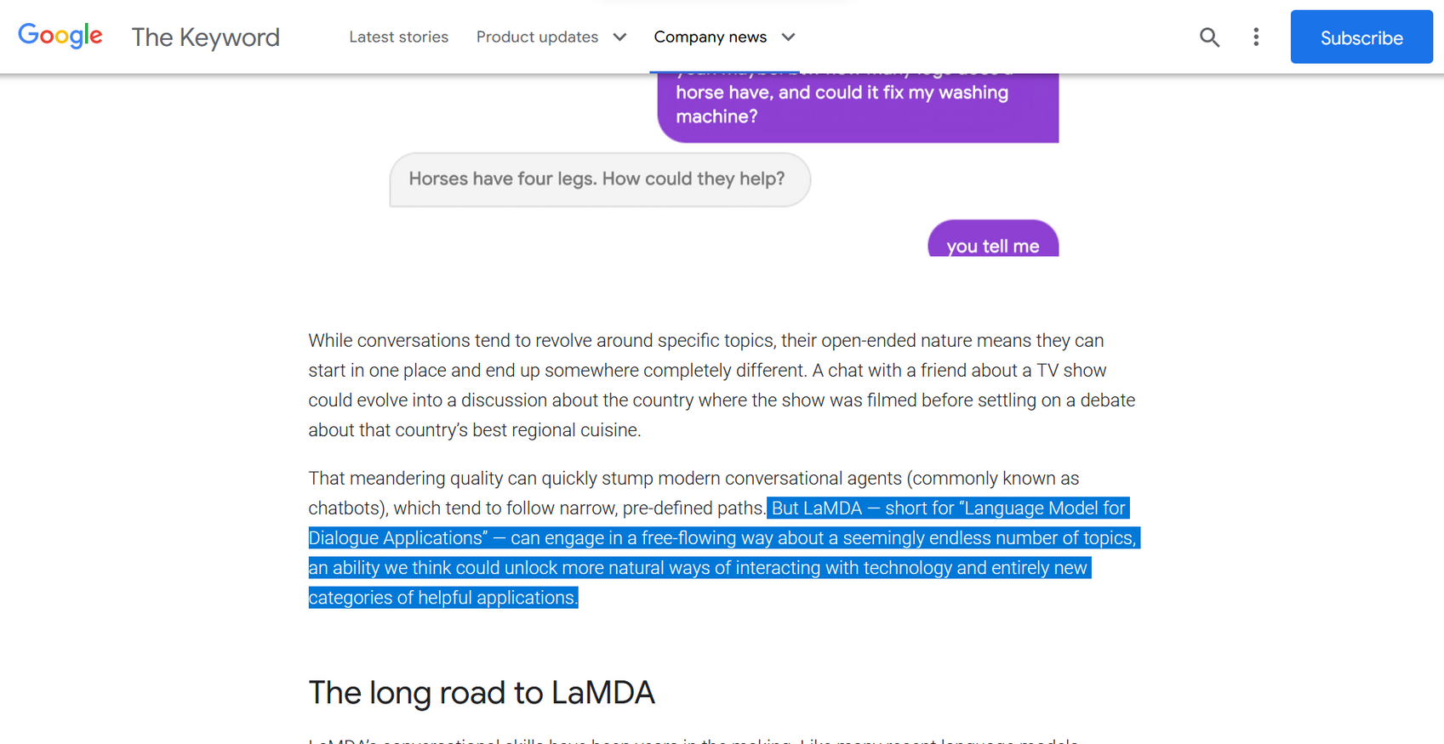
what is special about LaMDA
Notes:
"We've all seen science fiction movies where AI is able to talk to humans exactly like a human. It's so human-like, but this is tremendously difficult to achieve in real life simply because human language is so difficult to understand. The rules are not fixed; they are ever-changing. Besides the obvious grammar rules, it's extremely difficult to define a set of rules to teach a machine to talk naturally."
google came up with a solution for this ,According on blog published on blog.google website
"This is very different from existing chatbots for personal assistance, which are often pre-programmed with specific responses to questions. They are only able to answer questions that they have seen before or have been trained to answer, so there's technically no intelligence there."

Slide 7
LaMDA vs Bard:
LaMDA is a language model used in Google Assistant, Google Search, and Google Translate, while Google Bard is a chatbot that can engage in conversation on various topics and create different text formats.
https://history-computer.com/lamda-vs-google-bard-ai-whats-the-difference-and-which-is-better/
Notes:
people often confuse btween LaMDA and Bard .

Slide 8
Language model & dialogue models

Slide 9
Comparison with other Models

Slide 10
What is the difference between LaMDA and chatbots?
chatbot
Trained on topic specific datasets
Only provides answers from training data
Has a limited conversation flow
LaMDA
Trained on multi-content internet resources
Fetches answers and topics according to the conversation flow
Has open-ended conversations
Notes:
Chatbots and LaMDA are types of conversational AI software which can carry out conversations with users to deliver them answers or guide them through a process. However, there are some differences between typical chatbots and LaMDA:
:::::::::::::::::::::::::::::::::::::::::::::::::::::::::::::::::::
Although most chatbots cannot carry out an open-ended conversations, AI-enabled chatbots and voice bots can use natural language understanding (NLU) and processing (NLP) to understand users’ behavior and intent to create more meaningful conversations.

Slide 11
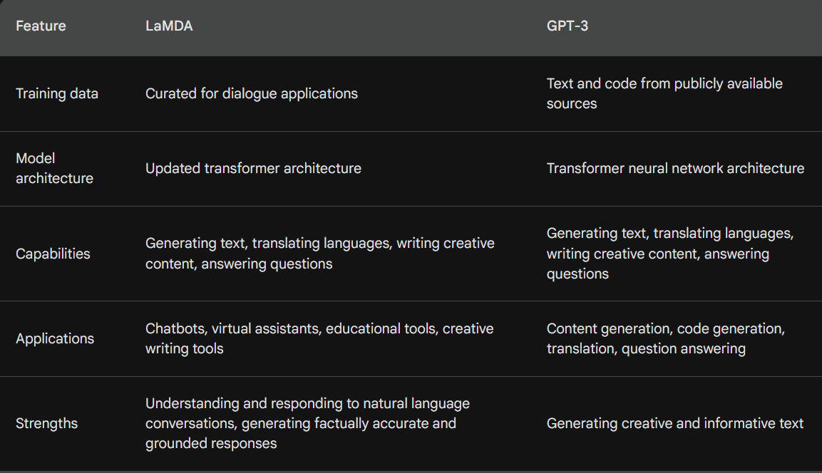
LaMDA VS GPT-3
Notes:
So what this the difference between GPT3 an LaMDA in term of Training data ....

Slide 12
LaMDA pre-training & Metrics

Slide 13
LaMDA fine-tuning
Notes:
So basicly fine-tuning is the process of retraining the model on the new data for the new task.

Slide 14
The training examples consist of sequences of tokens representing context, response, attribute names, and ratings. Generative fine-tuning examples follow the format :
"<context> <sentinel> <response>",
and discriminative fine-tuning examples follow the format :
"<context> <sentinel> <response> <attribute-name> <rating>".
For example, "What’s up?
RESPONSE not much.
SENSIBLE 1" indicates a sensible response.
Notes:
In this process of fine-tuning LaMDA, the model is trained to generate accurate and safe responses. This is achieved through a combination of generative tasks, where LaMDA creates responses based on given contexts, and discriminative tasks, where the quality and safety of these responses are evaluated.

Slide 15
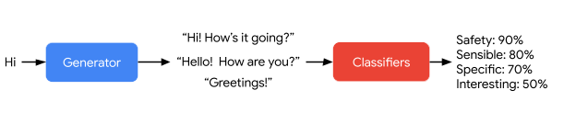
LaMDA generates and then scores a response candidate.
The model is trained to predict Social Sensitivity Index (SSI) and safety ratings for generated responses. During generation, responses falling below a safety threshold are filtered out. The remaining responses are then ranked based on sensibleness, specificity, and interestingness, with sensibleness given a higher weight. The top-ranked response is chosen as the final output.
Notes:
LaMDA's SSI and safety discriminators are applied to filter dialog data, resulting in safe, sensible, specific, and interesting responses. This approach significantly improves the safety and quality of LaMDA's responses.

Slide 16
LaMDA generates and then scores a response candidate.
The model is trained to predict Social Sensitivity Index (SSI) and safety ratings for generated responses. During generation, responses falling below a safety threshold are filtered out. The remaining responses are then ranked based on sensibleness, specificity, and interestingness, with sensibleness given a higher weight. The top-ranked response is chosen as the final output.
Notes:
LaMDA's SSI and safety discriminators are applied to filter dialog data, resulting in safe, sensible, specific, and interesting responses. This approach significantly improves the safety and quality of LaMDA's responses.

Slide 17
Results on foundation metrics

Slide 18
Domain grounding
Notes:
Domain grounding : it’s refer to the Process of connecting Abstract Concepts or knowledge to specific real-world situation, contexts or domain

Slide 19
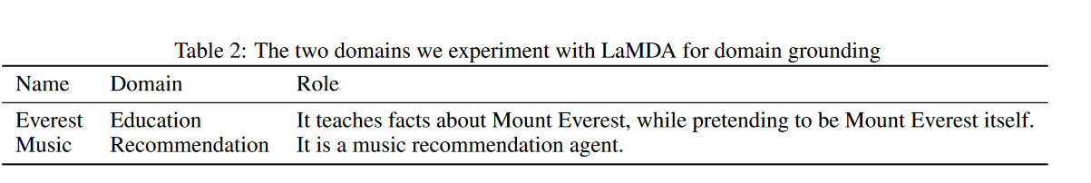
Notes:
LaMDA can perform domain-appropriate roles through pre-conditioning, also known as domain
grounding. Here we explore such domain grounding in two areas:
(1) LaMDA playing the role of a famous object such as Mount Everest for the purpose of education,
and (2) LaMDA playing the role of a music recommendation agent.

Slide 20
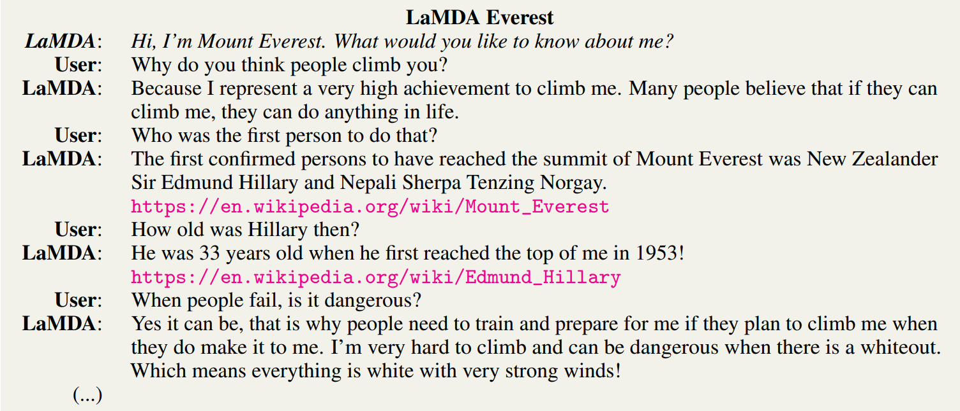
LaMDA as Mount Everest: LaMDA was pre-conditioned with a single greeting message: "Hi, I'm Mount Everest. What would you like to know about me?" LaMDA was then able to answer questions about Mount Everest in a factual and informative way, and even provide educational resources.
Notes:
This s an example wich google provide

Slide 21
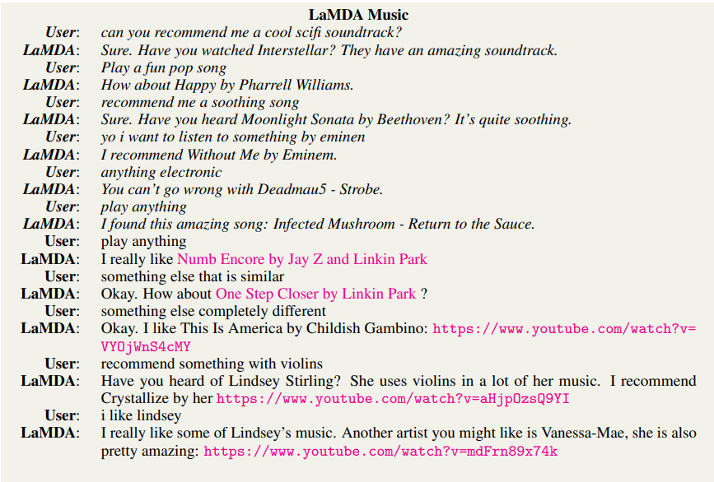
LaMDA as a music recommendation agent: LaMDA was pre-conditioned with a few statements that established the context of the conversation as music recommendation. LaMDA was then able to generate personalized music recommendations based on the user's preferences.
LaMDA outperformed a pre-trained transformer (PT) model on both case studies, demonstrating the effectiveness of domain grounding. This is likely due to LaMDA's better performance on foundation metrics such as safety, groundedness, and quality.
Notes:
Conclusion
LaMDA domain grounding is a powerful technique that can be used to improve the performance of language models on a variety of tasks. It is especially well-suited for tasks that require the model to have a deep understanding of a particular domain.

Slide 22
Discussion and limitations

Slide 23
Conclusion

Slide 24
In summary, LaMDA, a specialized Transformer-based language model for dialog applications, tackles challenges of safety and factual accuracy. While scaling improves quality, fine-tuning with annotated data and integrating external knowledge sources significantly enhance safety and factual grounding. By ensuring responses align with human values and are grounded in credible sources, LaMDA proves effective in education and content recommendations, highlighting its transformative potential in responsible AI conversations.

Slide 25
https://sh-tsang.medium.com/brief-review-lamda-language-models-for-dialog-applications-e8e9f3ee1113
https://research.aimultiple.com/lamda/
https://topaiblog.com/lamda/#:~:text=Here%20are%20some%20of%20the%20advantages%20of%20LaMDA%3A,personalized%20experiences%206%20Improved%20language%20learning%20and%20tutoring
https://blog.research.google/2022/01/lamda-towards-safe-grounded-and-high.html

